Slide 1
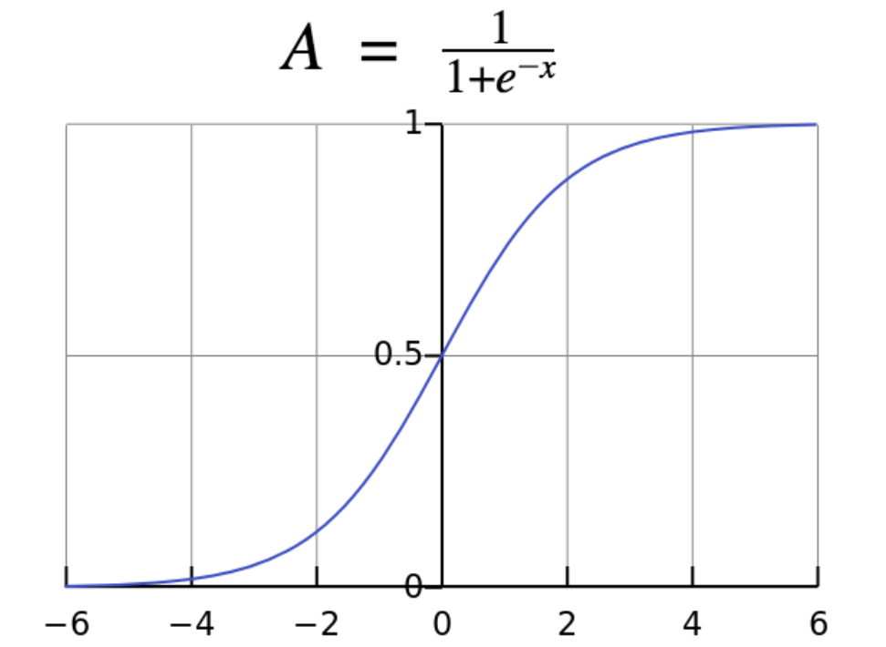

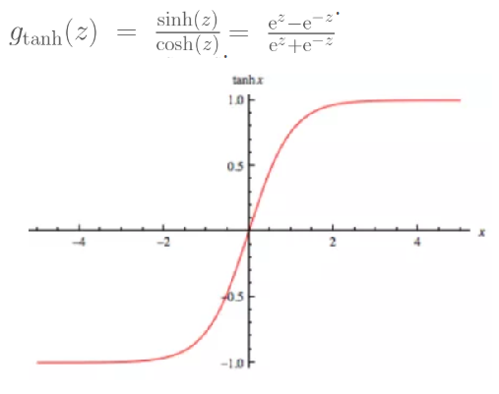
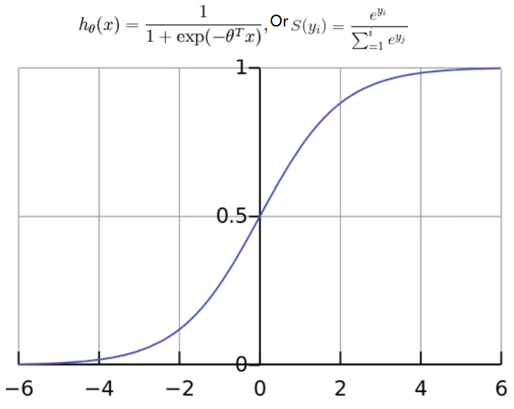

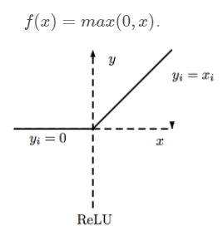
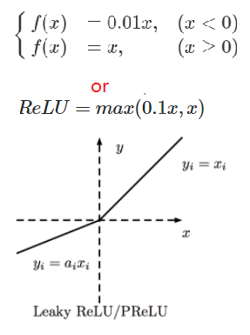
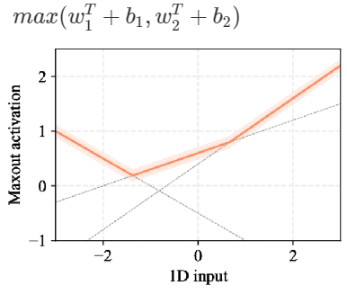
 | When use? | If Linear | If could stack layers | Pros | Cons | Range
Linear Function (y=ax) | Regression | Y | N
Logistic Sigmoid | binary classification; | N | Y | Clear Distinction on prediction; | Dense and costly Almost all neurons to fire in an analog way Slow in convergence; avoided due to the vanishing gradient problem | (0,1)
Tanh | 2 Classes classification; Feed-forward nets | N | Y | No slow in convergence | 1. avoided due to the vanishing gradient problem | (-1,1)
Softmax | Output; Multi classes Classification for probability | N | Y |  |  | (0,1)
Relu | Hidden layer; Most popular (begin with using ReLU!) | Monotonic N | Y | Less cost than linear, sigmoid 6 times improvement in convergence from Tanh | Only used in hidden layers Result in dead neurons (weight update) | (0, infinite)
Leaky Relu | Avoid dead neuron | Monotonic N |  | Reduce dead neuron (fix the “dying ReLU” problem) | 1. the results are not always consistent.
Maxout (Relu+Leaky Relu) | Avoid dead neuron | piecewise linear (up to k pieces) |  | Reduce dead neuron (fix the “dying ReLU” problem)

